Slide 1

LIC AGENCY for Life Long Income to YOU & Your Family

Slide 2
WHY
LIC AGENCY ?
WHAT ARE THE USES ??

Slide 3


No Bossism
  You are the BOSS
  to yourself
  You need not work under anybody. You are a free bird.

Slide 4


No Capital required
    Requirements are:
      A smile
      A few good words
      A little physical work &
      A strong thrust for earning

Slide 5

Self-Employment
  No retirement.
  No Golden shake hand.
  Life long work.
  High net worth people always like to be self-employed

Slide 6

Highly Potential:
  Population growth of India is 2 crores per annum.
  We produce one AUSTRALIA every year.

Slide 7
In India only 24% of Insurable Population is insured till date.
Remaining 76% of Insurable population is yet to be insured.
There is a huge untapped market to explore.

Slide 8

Increasing Population,
Increasing Insurance needs,
Continuous launching of New Life Insurance policies
have been increasing Life
Insurance SALES every year
in India.

Slide 9


Work according to your own TIMINGS
  Great opportunity
  to manage your
  free time
  Part time agents are most successful agents

Slide 10

Unlimited INCOME
  You can decide your own income
  Regular Cash Flow

Slide 11

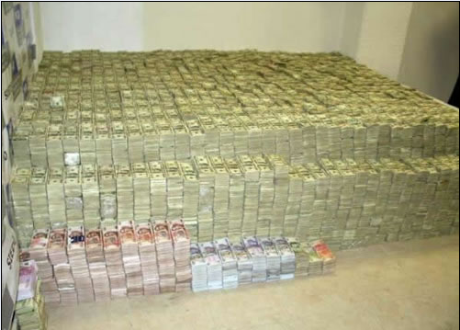
Unlimited Earning Opportunities:

Slide 12
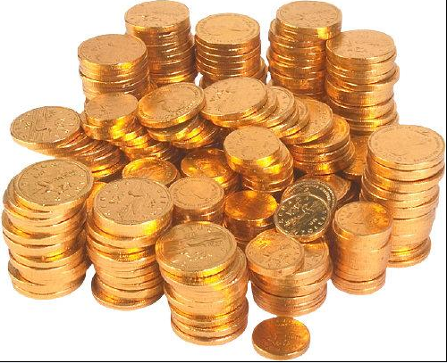

LIC’s Insurance Agency is the Highest Paid Profession in the World……

Slide 13

Commission Rates
The Agent will get the following Commission Rates:
25% of 1st year premium with 10% Bonus Commission.
7.5% of 2nd & 3rd year premium.
5% from 4th year to end of the policy term.
Every time a Policyholder pays his Installment Premium,
the Agent receives his Commission.

Slide 14

THAT MEANS
YEAR
PREMIUM
%
COMMISSION
1st
2nd
3rd
4th
5th
6th
7th
8th
9th
10th
11th
12th
13th
14th
15th
16th
17th
18th
19th
20th
10,000
10,000
10,000
10,000
10,000
10,000
10,000
10,000
10,000
10,000
10,000
10,000
10,000
10,000
10,000
10,000
10,000
10,000
10,000
10,000
2,00,000
35%
7.5%
7.5%
5%
5%
5%
5%
5%
5%
5%
5%
5%
5%
5%
5%
5%
5%
5%
5%
5%
3,500
750
750
500
500
500
500
500
500
500
500
500
500
500
500
500
500
500
500
500
Total Commission on 1 Policy 13,500

Slide 15
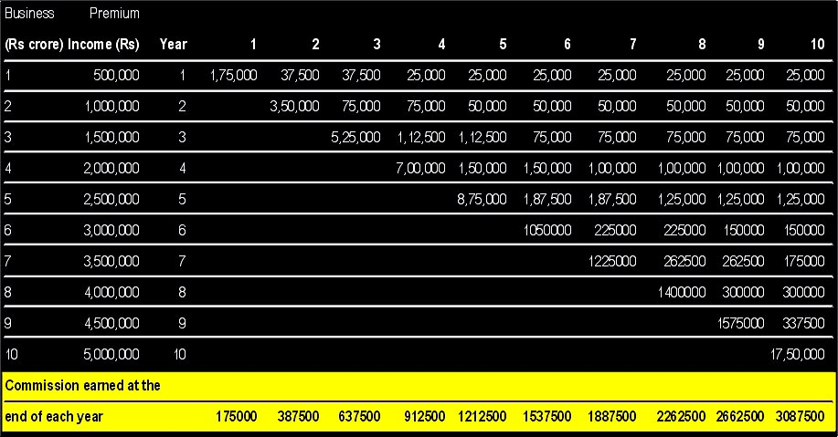

Magic of
Renewal Commissions
Total Premium Collection - 2,75,00,000
Total Renewal commission@5% will be 13,75,000 P.A.
Recurring Consistent Income 1,14,583 P.M.
SOURCE
Business standard
24-09-2001.

Slide 16

LIC Agency is a Social Service & Nation building activity
  LIC has invested
  Rs. 24,01,457 Crores
  in our Nation building
  activities from
  1956 to 2020.

Slide 17

Own Pension:
If LIC agent works for 5 years,
As long as his policyholders pay renewal premiums,
He…. Later his Family Members
will receive the
renewal commission. (ERC & HRC)

Slide 18
Social Status
  LIC agency gives a good recognition in the society.
  Adding “LIC” to your Vehicle or to your Visiting Card will give a status

Slide 19

No boundaries to do business
  Any where in our
    Country,
    World,
    Universe.

Slide 20

Professionalism
  Like any other
  Financial,
  Legal,
  Accountancy,
  Health consultants,
LIC agent is an Insurance consultant

Slide 21
Recognition –
  B.M. club membership
  D.M. club membership
  Z.M. club membership
  C.M. club membership
  M.D.R.T.
  Corporate club membership

Slide 22








Benefits to Club Members –
  Car or Motorcycle
  Housing Loan
  Office allowance
  Computer
  Furniture
  Marriage advance
  Flight journey
  & so many benefits.

Slide 23

Bright Career
    Agent →
    Dev. Officer →
    Branch Manager →
    S.D.M. →
    Zonal Manager →
    Chairman

Slide 24

Regular Training to meet the changes in the market
  Branch level Training
  Specialised Training at Sales Training Centers

Slide 25

Inner talents will be recognised and developed
  Specialisation in MILI
  (Mathematics in life insurance
  HNI
  Child & Female Insurance
  Income Tax savings

Slide 26
Public Relations can be developed
  Many of our LIC Agents have become Local Leaders, MLAs, MPs

Slide 27
Excellent Job satisfaction
  When the dependent of a customer receives claim money from LIC

Slide 28



100% white money
  All the Commission is taxable income.
  Agents submit I.T. returns every year
  Income Tax will be deducted at source.

Slide 29
JOB profile of LIC agent :-
Out Going: Loving to go out & meet People.
Plan Presentation: Suggesting suitable PLANS that fulfill the NEEDS of the Prospect.
Closing the Sale: Convincing the Prospect that you have suggested the best possible solution for his Need & ask for the Order.
After Sales Service: Provide efficient after sales service and claims settlement.

Slide 30


NOT necessary:-
LIC Agent need not be a highly talkative.
LIC Agent need not be a highly qualified.
LIC Agent need not be a highly intelligent.
LIC Agent need not have rich back ground.
LIC Agent need not have cast back ground.

Slide 31


Any Indian….
who
completed 18 years age…
completed 10th Class….
can take “LIC AGENCY”

Slide 32

SUCCESS formula for LIC Agents:-
Prepare a List of your Friends & Relatives.
The list is called “Prospective List.”
It is good if you prepare very big List.
Inform all the persons in that List, as You have taken LIC Agency & You will meet them shortly.
If you could get policies from 2 out of 10 persons in the list…, You will become a Top Agent.
No body will give a policy as soon as you ask them. Somebody may take policy immediately, somebody after a month or year or later.

Slide 33

SUCCESS formula for LIC Agents:-
Daily... meet 4 persons, who are well known to you, explain them LIC policies, & ask them to take a policy.
Daily… get acquainted with 4 new persons. Collect references (address) from your Friends, Relatives & Customers.

Slide 34

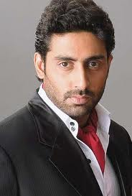
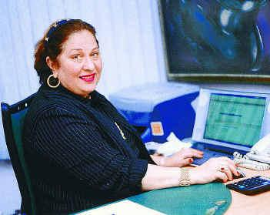

Ask these people….
Dipti Bhatnagar
Abhishek Bachhan
Ragini Yadav
Ritu Nanda

Slide 35
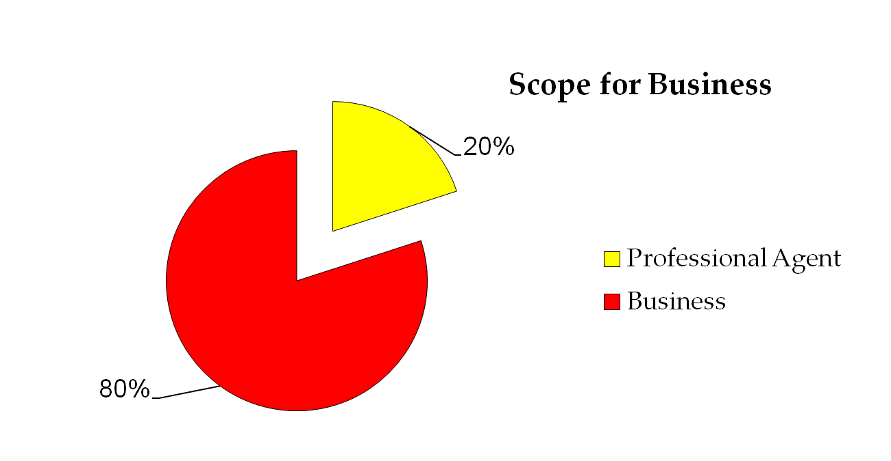
Only 20% of total agency force are working in a Professional Capacity. These 20% agents bring for more than 80% of total Life Insurance Business.
Be “One” among the “Professionals” and earn your fortune.

Slide 36
COMPARISION….
Employee | LIC Agent
Salary | Commission
Pension (contributory) | Renewal + Pension
Gratuity | Gratuity
L. T. C. | L. T. C.
2 Wheeler Loan | 4 Wheeler (Car) Advance
Office Allowance × | Office Allowance
Housing Loan | Housing Loan
Festival Advance | Festival Advance
Mediclaim | Mediclaim
Telephone Facility | Telephone Facility
10am-6pm OFFICE JOB | OWN BOSS

Slide 37
COMPARISION….
Profession | Degree | Investment | Time | Workplace
Doctor
C.A.
Lawyer
Engineer
LIC Agent | X | X | X | X
√ | √ | √ | √
√ | √ | √ | √
√ | √ | √ | √
√ | √ | √ | √

Slide 38
Time : Money
√ | X | 10% | - Retired & Unemployed
X | √ | 5% | - Professionals
X | X | 80% | - Salaried People
√ | √ | 5% | - Agents

Slide 39
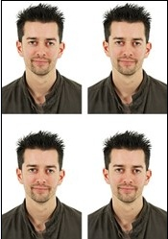
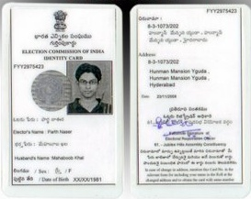
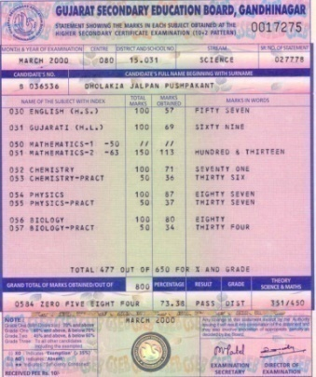
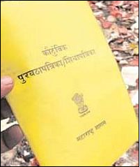
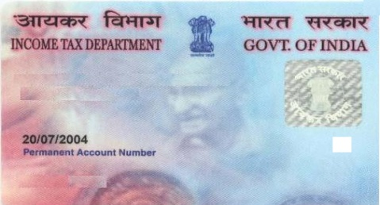

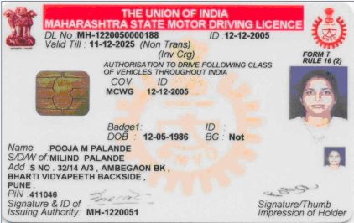
Documents required:--
4 Passport size color photographs
Educational Proof :-
1. S.S.C. / 10th Class Mark Sheet / Certificate
Age Proof :- (Any One)
1. S.S.C. Mark Sheet
2. Any T.C.
3. Passport
Address Proof :- (Any One)
1. Aadhar Card
2. Passport
3. Voter ID
4. Ration Card
5. Driving License
6. Bank Statement
PAN CARD
BANK a/c Particulars

Slide 40


Join as an
&
Get a future
LIC AGENT
GOLDEN

Slide 41


If “Dhana Lakshmi”
knocks at your door,
do you welcome her or not ?
She/Agency will give you:
  Name
  Fame
  Money
  Satisfaction
  Confidence

Slide 42
Prashant H.Nirkhi
[Development & Recruitment Officer]
Life Insurance Corporation of India
Branch: 883, Mumbai [ Div I ]
Mobile: 09220201111, 09324313624
Email@: phnirkhi@gmail.com
Website-www.insurancecareer.org

Slide 43


